Slide 1
Recertification Design
OCNZ Conference 2019

Slide 2
Aims
To consider what is already being done in the realm of Quality Assurance in practice
To gather your views on what a recertification scheme could look like

Slide 3
Aims of Recertification Activities
Activities are relevant across the Capabilities
Balanced across an individual’s own practice
Activities create change in practice
Activities benefit patients
Activities are recorded
GOsC (2018) Continuing Professional Development Guidelines

Slide 4
Practitioner Characteristics
A good scheme requires osteopaths:
Creating a respectful environment where colleagues can share details of their practice openly
Having the skills to give and receive feedback constructively
Demonstrating attitudes of curiosity and the ability to learn from every encounter with colleagues
Valuing the new knowledge and insights that colleagues and patients can bring
GOsC (2018) Continuing Professional Development Guidelines

Slide 5
Components of a ‘Good’ Scheme
A way to accurately assess learning needs
Development of a plan to address those needs
Access to a range of appropriate activities that suit individual learning styles and are likely to improve practice

Slide 6
Components of a ‘Good’ Scheme
Peer interaction to reduce the risk of professional isolation
An avenue for formal peer (and sometimes patient) feedback
Reflection on learning in terms of practice improvement
Heslop, R. (2019) Continuing competence requirements for osteopaths

Slide 7
Selected Aspirational Principles
Continuing Competence Programmes should:
Be developed along with [practitioners], with quality healthcare for patients as it’s primary purpose
Be built on an expectation that learning is ongoing and integrated into practice, not a point-in-time administrative requirement
Not impose a disproportionate administrative or financial burden
Employ a variety of interactive learning techniques and address accepted and relevant competencies
IAMRA (2018) Statement on Continued Competency

Slide 8
Benefits
For [practitioners], a well-managed and constructed Continued Competency system can encourage self-reflection and foster their intrinsic motivation to improve, thereby affirming their inherent professionalism. It can also add structure to [practitioners’] learning efforts, making these more efficient, effective, and meaningful.
IAMRA (2018) Statement on Continued Competency

Slide 9
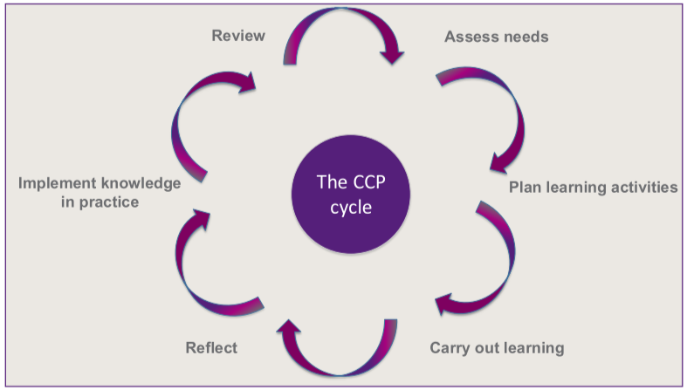
Proposed CCP Learning Cycle
Heslop, R. (2019) Continuing competence requirements for osteopaths

